Slide 1
To form a clinical center of excellence after cardiac arrest.
Paulien H. Goossens, MD, PhD
Rehabilitation specialist
Merem, The Netherlands

Slide 2
Who is my audience?
Cardiologist or intensivist
Neurologist
Rehabilitation doctor
Paramedic
Nurse
Other

Slide 4
Wich barrier is most important?
1. Logistic problems
2. No formal cooperation between cardiac and cognitive rehabilitation
3. Too few patients
4. Limited knowledge on cognitive problems by cardiac team
5. Increased administrative load
6. Financial barrier

Slide 5
Barriers
Logistic problems (44%)
No formal cooperation between cardiac and cognitive rehabilitation (36%)
Too few patients (36%)
Limited knowledge on cognitive problems (31%)
Fear of increased administrative load (21%)
Financial barriers (3%)
Neth Heart J 2018 Boyce et al. Attention needed for cognitive problems in patients after out-of-hospital cardiac arrest: an inventory about daily rehabilitation care.

Slide 6
Transfer of patients
Cognitive rehab
Screening emotions
Care for spouses
Screening cognition
Center of excellence
Cardiac rehab
Neuro
psychology
information
monitor
Formal agreements

Slide 9
Donabedian’s model
patient
features
process
outcomes
structures

Slide 10
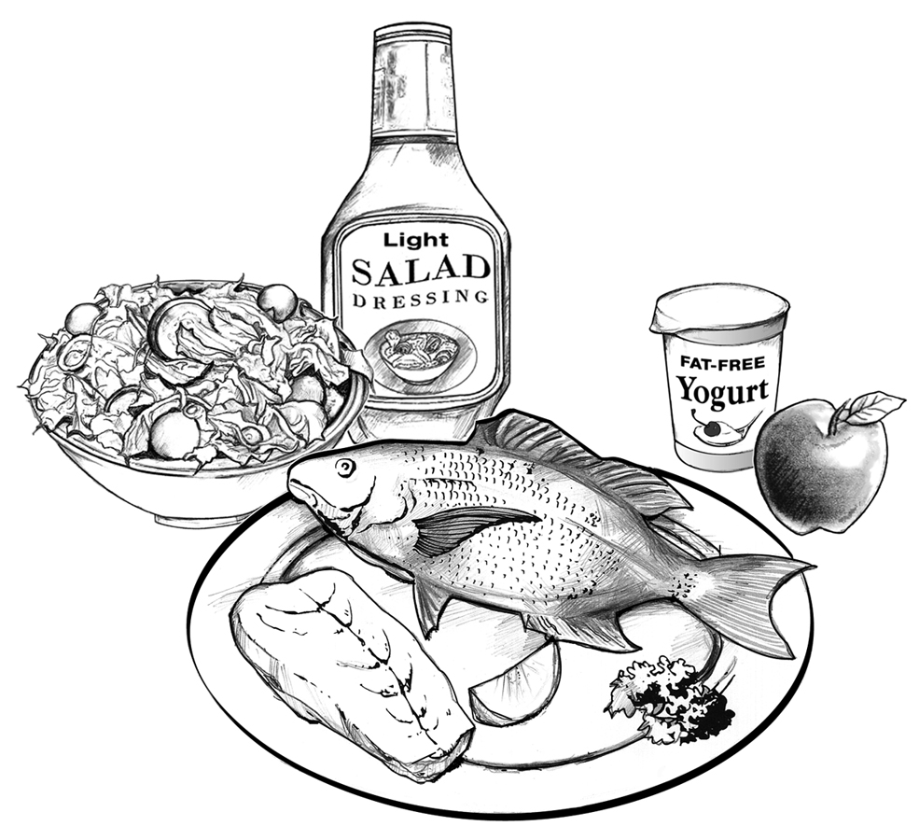
Topic covered?
Ideal situation?
Improvements needed?

Slide 11
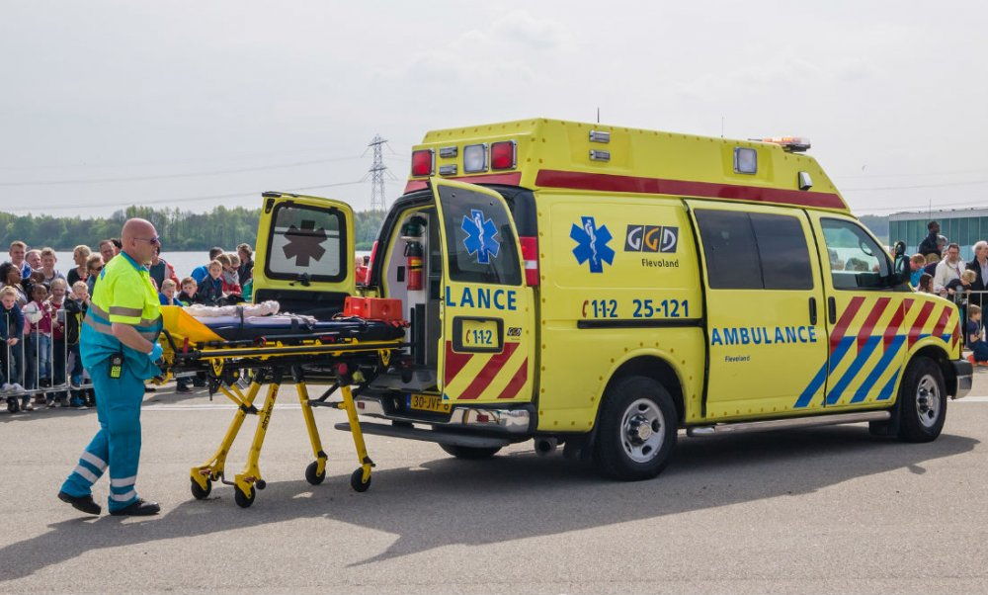
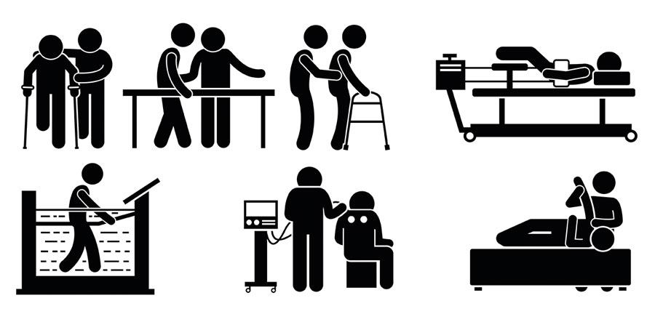
Patients
Ann Rehabil Med 2014 Kim Cardiac rehabilitation after acute myocardial infarction resuscitated from cardiac arrest.

Slide 12
Do you have a formal cooperation?
1. yes, between the ambulance service, hospital , cardiac and cognitive rehabilitation service.
2. yes, between the hospital , cardiac and cognitive rehabilitation service.
3. yes, between the hospital and cognitive rehabilitation service.
4. yes, between the hospital and cardiac rehabilitation service.
5. No we don’t

Slide 13
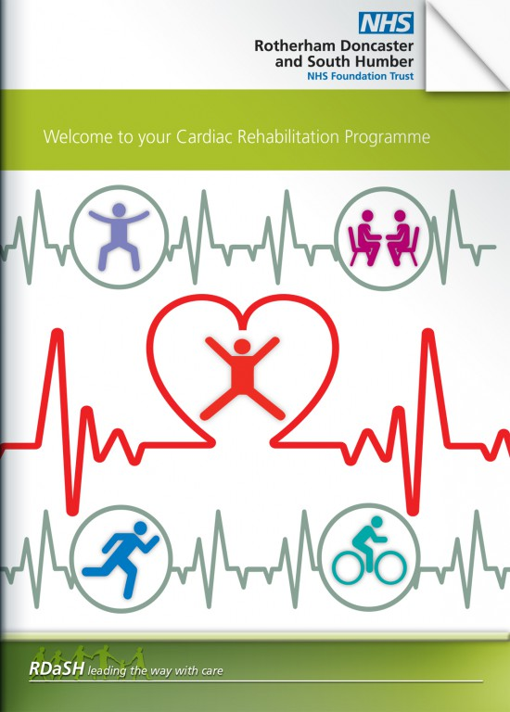
Cardiac rehabilitation
Goal: resume participation
Physical condition
Stress management
Sexual participation
Social support
Life style (smoking, diet, etc)
Return to work
Guidelines European Society of Cardiology 2017

Slide 14
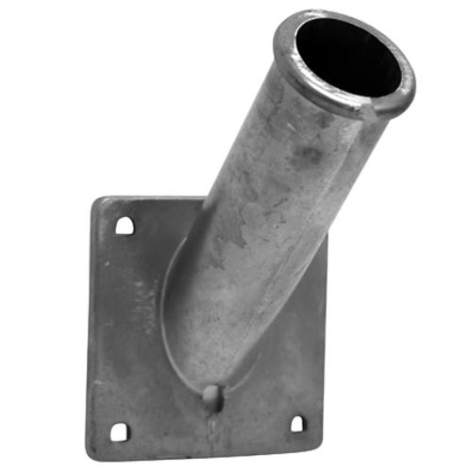
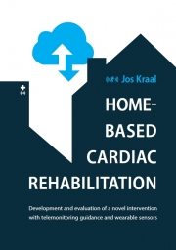
Cardiac rehabilitation
Heart 2019 Maddison Effects and costs of real-time cardiac telerehabilitation: randomised controlled noninferiority trial.

Slide 15
Multiple consequences after cardiac arrest

Slide 16
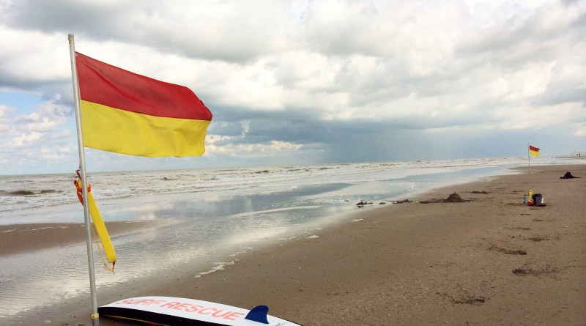
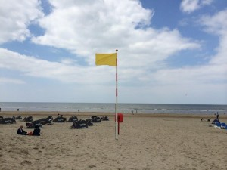
Cardiac rehabilitation
Most OHCA survivors need complex cardiac rehabilitation

Slide 17
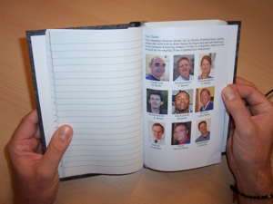
Provide information
http://www.lifeaftercardiacarrest.com/
BMC Health Serv Res. 2014 Moulaert ‘Stand still …, and move on’ , an early neurologically-focused follow-up for cardiac arrest survivors and their caregivers: a process evaluation

Slide 18
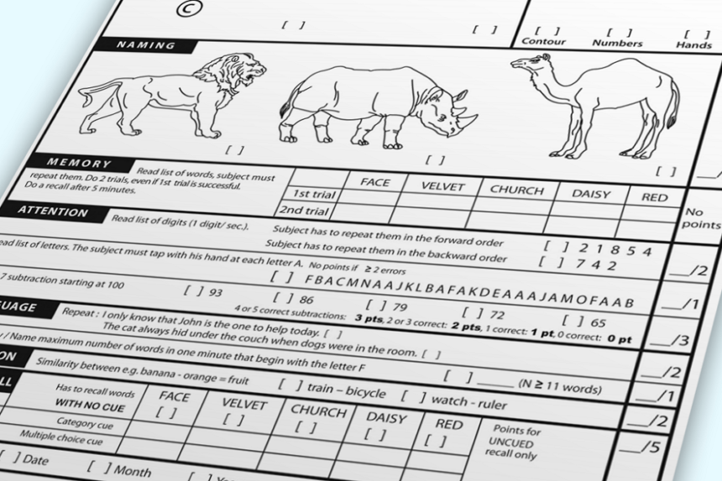
Screening: cognition
Resuscitation 2017 Koller Comparison of three cognitive exams in cardiac arrest survivors.

Slide 19
What screening do you use?
Clinical observations by nurses
Structured observation of tasks by nurses or OT
Concise screening test using MOCA
Concise screening test using other test
Full neuropsychological test for all OHCA survivors
Anamnesis of the partner

Slide 20
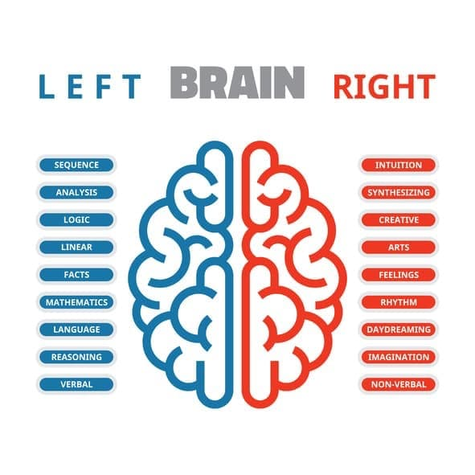
Neuropsychological testing
Notes:
resolutie afbeelding lijkt wat laag....

Slide 21
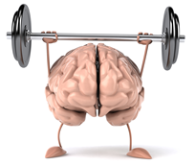
Relation cognition and exercise capacity
Resuscitation 2017 Boyce Out-of-hospital cardiac arrest survivors with cognitive impairments have lower exercise capacity.

Slide 22
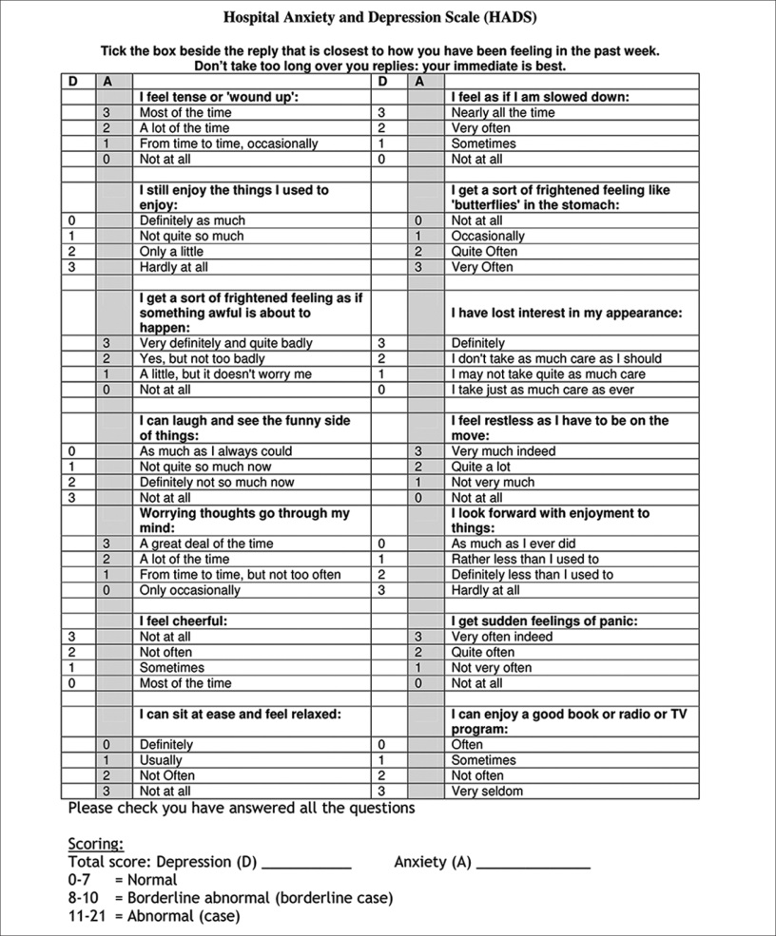
Screening: emotional consequences
QoL
Recurrence rate
Monaldi Arch Chest Dis 2018 , Sommaruga Best practice in psychological activities in cardiovascular prevention and rehabilitation: position paper.

Slide 23
the spouse!
INFORMATION
Emotional care / treatment
Resuscitation courses
Patient and Partner Education Programme 4 ALL (PPEP-4-ALL)
Resuscitation 2018 Van’t Wout Hofland et al. Long-term quality of life of caregivers of cardiac arrest survivors and the impact of
witnessing a cardiac event of a close relative.
J Adv Nurs 2018 Cartledge et al. Understanding patients and spouses experiences of patient education following a cardiac event and eliciting
attitudes and preferences towards incorporating cardiopulmonary resuscitation training: a qualitative study.

Slide 24
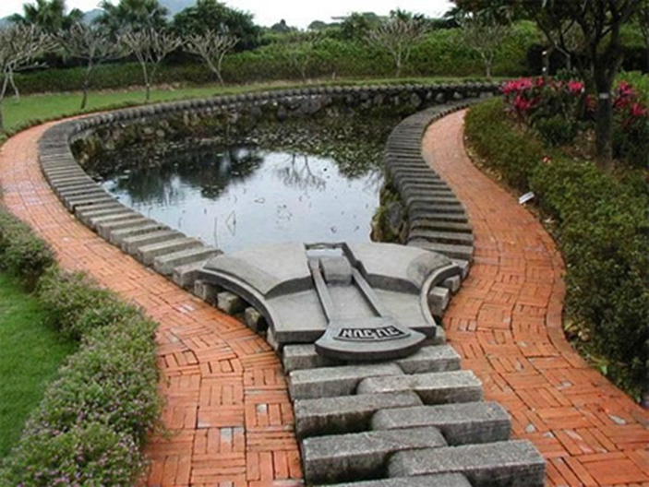
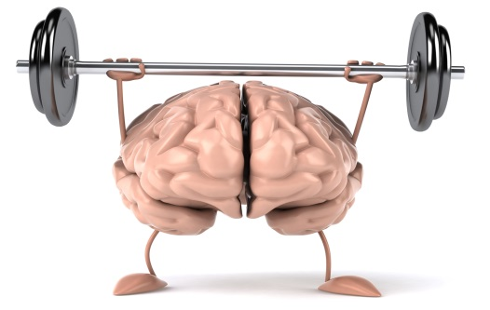

Slide 25
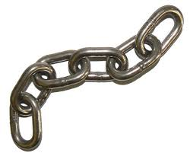
Formal agreements
Eur J Cardiovasc Nurs 2017 Haydon A systematic review and meta-synthesis of the qualitative literature exploring the experiences and quality of life of survivors of a cardiac arrest.

Slide 26
Requirements
Agreements on responsibilities
Financial issues
Database

Slide 27
Follow up
Questionnaires
Telephone / visit
UK support group for survivors and their families

Slide 28
Evaluate and improve

Slide 29
Made possible by
Liesbeth Boyce, PhD student
Jan Bosch en Jan de Nooij, ambulance service
Christian Heringhaus, first aid specialist
Prof Martin Schalij and Henk van Exel, cardiologists
Prof Thea Vliet-Vlieland, epidemiologist,
Leti Van Bodegom, implementation specialist
And many others!

Slide 30
Questions?
Fragen?
Frågor?
?
Preguntas?
Domandare?
Vragen?

Slide 31
To build a follow up system after cardiac arrest
Thomas R. Keeble, MD, cardiologist Essex Cardiothoracic Centre UK
Paulien H. Goossens, MD PhD, rehabilitation specialist The Netherlands

Slide 32
Discussion item 1
The General Data Protection Regulation
hampers the formation
of adequate care networks for
patients after OHCA

Slide 33
Discussion item 2
The guidelines should take up
cognitive and emotional screenings
during the hospital phase
The concise
MOCA and HADS
seem suited for this purpose

Slide 34
Discussion item 3
Long term follow up
of CA survivors
by cardiologists
makes sense in the light of
Value Based Health Care.

